Slide 1
Natural Language Processing
Lecture 6—1/29/2015
Susan W. Brown

Slide 2
Today
Problem set 1 feedback
N-grams
Evaluation
Smoothing

Slide 3
Estimating Bigram Probabilities
The Maximum Likelihood Estimate (MLE)

Slide 4
An Example
<s> I am Sam </s>
<s> Sam I am </s>
<s> I do not like green eggs and ham </s>

Slide 5
Maximum Likelihood Estimates
The maximum likelihood estimate of some parameter of a model M from a training set T
Is the estimate that maximizes the likelihood of the training set T given the model M
Suppose the word “Chinese” occurs 400 times in a corpus of a million words (Brown corpus)
What is the probability that a random word from some other text from the same distribution will be “Chinese”
MLE estimate is 400/1000000 = .004
This may be a bad estimate for some other corpus
But it is the estimate that makes it most likely that “Chinese” will occur 400 times in a million word corpus.

Slide 6
Berkeley Restaurant Project Sentences
can you tell me about any good cantonese restaurants close by
mid priced thai food is what i’m looking for
tell me about chez panisse
can you give me a listing of the kinds of food that are available
i’m looking for a good place to eat breakfast
when is caffe venezia open during the day

Slide 7
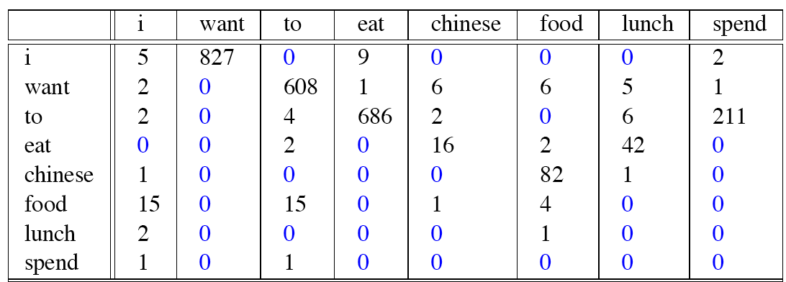
Bigram Counts
Out of 9222 sentences
Eg. “I want” occurred 827 times

Slide 8
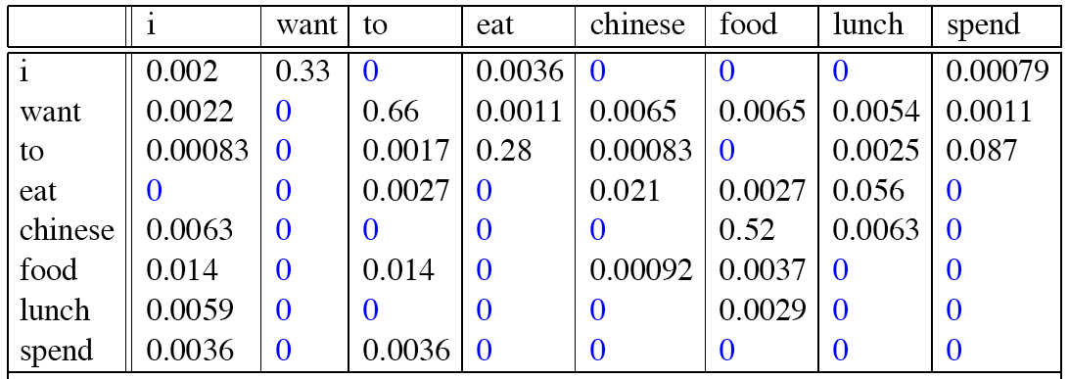
Bigram Probabilities
Divide bigram counts by prefix unigram counts to get probabilities.

Slide 9
Bigram Estimates of Sentence Probabilities
P(<s> I want english food </s>) =
P(i|<s>)*
P(want|I)*
P(english|want)*
P(food|english)*
P(</s>|food)*
=.000031

Slide 10
Kinds of Knowledge
As crude as they are, N-gram probabilities capture a range of interesting facts about language.
P(english|want) = .0011
P(chinese|want) = .0065
P(to|want) = .66
P(eat | to) = .28
P(food | to) = 0
P(want | spend) = 0
P (i | <s>) = .25
World knowledge
Syntax
Discourse

Slide 11
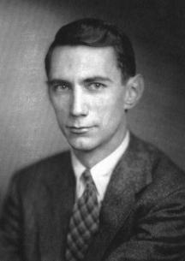
Shannon’s Method
Assigning probabilities to sentences is all well and good, but it’s not terribly illuminating . A more entertaining task is to turn the model around and use it to generate random sentences that are like the sentences from which the model was derived.
Generally attributed to
Claude Shannon.

Slide 12
Shannon’s Method
Sample a random bigram (<s>, w) according to the probability distribution over bigrams
Now sample a new random bigram (w, x) according to its probability
Where the prefix w matches the suffix of the first.
And so on until we randomly choose a (y, </s>)
Then string the words together
<s> I
I want
want to
to eat
eat Chinese
Chinese food
food </s>

Slide 13
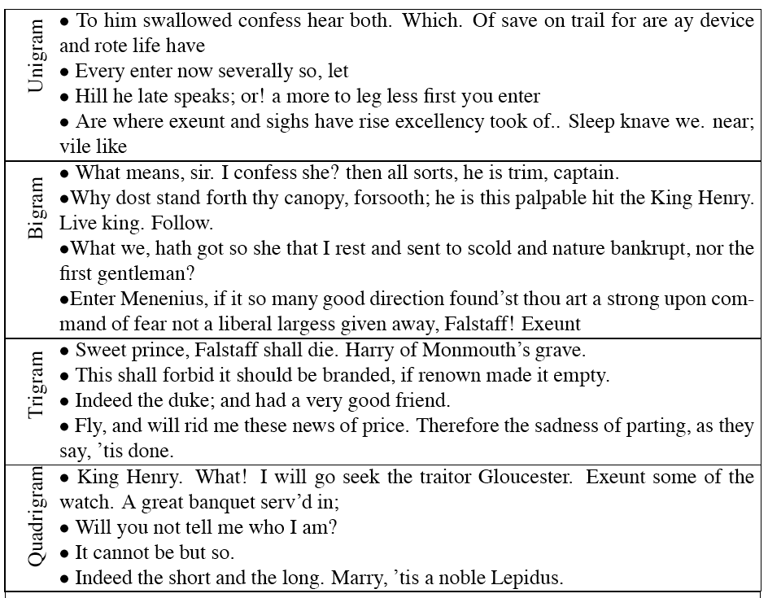
Shakespeare

Slide 14
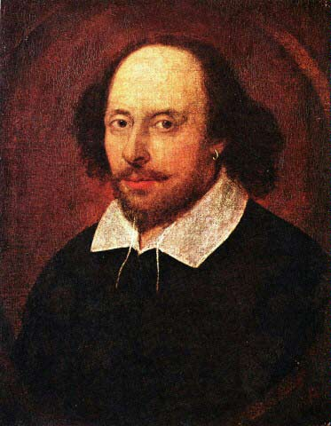
Shakespeare as a Corpus
N=884,647 tokens, V=29,066
Shakespeare produced 300,000 bigram types out of V²= 844 million possible bigrams...
So, 99.96% of the possible bigrams were never seen (have zero entries in the table)
This is the biggest problem in language modeling; we’ll come back to it.
Quadrigrams are worse: What's coming out looks like Shakespeare because it is Shakespeare

Slide 15
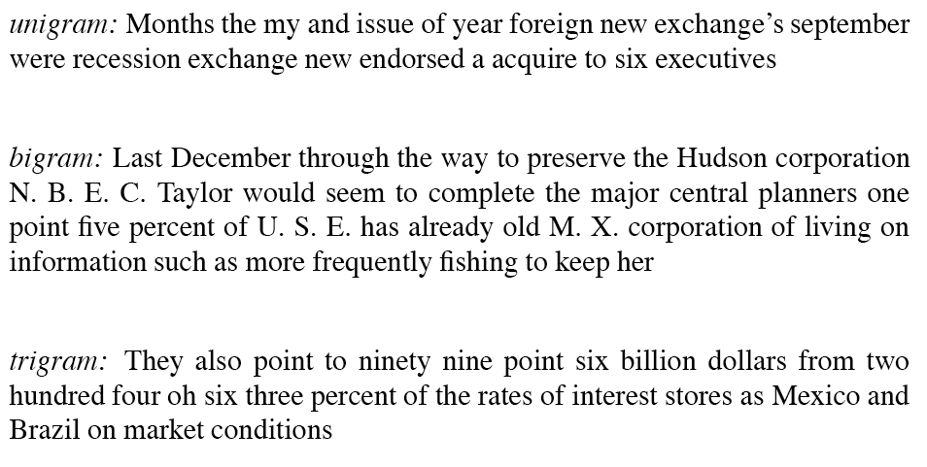
The Wall Street Journal is Not Shakespeare

Slide 16
Evaluating N-Gram Models
Best evaluation for a language model
Put model A into an application
For example, a speech recognizer
Evaluate the performance of the application with model A
Put model B into the application and evaluate
Compare performance of the application with the two models
Extrinsic evaluation

Slide 17
Difficulty of extrinsic (in-vivo) evaluation of N-gram models
Extrinsic evaluation
This is really time-consuming
Can take days to run an experiment
So
As a temporary solution, in order to run experiments
To evaluate N-grams we often use an intrinsic evaluation, an approximation called perplexity
But perplexity is a poor approximation unless the test data looks just like the training data
So is generally only useful in pilot experiments (generally is not sufficient to publish)
But is helpful to think about.

Slide 18
Model Evaluation
How do we know if our models are any good?
And in particular, how do we know if one model is better than another.
Well Shannon’s game gives us an intuition.
The generated texts from the higher order models sure look better.
That is, they sound more like the text the model was obtained from.
The generated texts from the WSJ and Shakespeare models look different
That is, they look like they’re based on different underlying models.
But what does that mean? Can we make that notion operational?

Slide 19
Evaluation
Standard method
Train parameters of our model on a training set.
Look at the models performance on some new data
This is exactly what happens in the real world; we want to know how our model performs on data we haven’t seen
So use a test set. A dataset which is different than our training set, but is drawn from the same source
Then we need an evaluation metric to tell us how well our model is doing on the test set.
One such metric is perplexity

Slide 20
But First
But once we start looking at test data, we’ll run into words that we haven’t seen before (pretty much regardless of how much training data you have.
With an Open Vocabulary task
Create an unknown word token <UNK>
Training of <UNK> probabilities
Create a fixed lexicon L, of size V
From a dictionary or
A subset of terms from the training set
At text normalization phase, any training word not in L changed to <UNK>
Now we count that like a normal word
At test time
Use UNK counts for any word not in training

Slide 21
Perplexity
The intuition behind perplexity as a measure is the notion of surprise.
How surprised is the language model when it sees the test set?
Where surprise is a measure of...
Gee, I didn’t see that coming...
The more surprised the model is, the lower the probability it assigned to the test set
The higher the probability, the less surprised it was

Slide 22
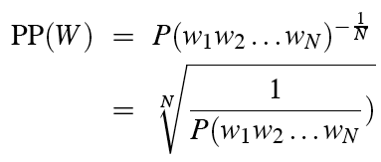
Perplexity
Perplexity is the probability of a test set (assigned by the language model), as normalized by the number of words:
Chain rule:
For bigrams:
Minimizing perplexity is the same as maximizing probability
The best language model is one that best predicts an unseen test set

Slide 23
Lower perplexity means a better model
Training 38 million words, test 1.5 million words, WSJ

Slide 24
Practical Issues
We do everything in log space
Avoid underflow
(also adding is faster than multiplying)

Slide 25
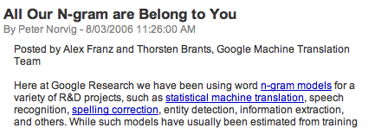
Google N-Gram Release

Slide 26
Google N-Gram Release
serve as the incoming 92
serve as the incubator 99
serve as the independent 794
serve as the index 223
serve as the indication 72
serve as the indicator 120
serve as the indicators 45
serve as the indispensable 111
serve as the indispensible 40
serve as the individual 234

Slide 27
Google Caveat
Remember the lesson about test sets and training sets... Test sets should be similar to the training set (drawn from the same distribution) for the probabilities to be meaningful.
So... The Google corpus is fine if your application deals with arbitrary English text on the Web.
If not then a smaller domain specific corpus is likely to yield better results.

Slide 28
Break
My office hours are now in the Engineering building. See class home page for room numbers.
Programming assignment is posted on the website: “Assignment 1”. Due February 5th.
Programming assignment questions?

Slide 29
Smoothing Dealing w/ Zero Counts
Back to Shakespeare
Recall that Shakespeare produced 300,000 bigram types out of V²= 844 million possible bigrams...
So, 99.96% of the possible bigrams were never seen (have zero entries in the table)
Does that mean that any sentence that contains one of those bigrams should have a probability of 0?
For generation (shannon game) it means we’ll never emit those bigrams
But for analysis it’s problematic because if we run across a new bigram in the future then we have no choice but to assign it a probability of zero..

Slide 30
Zero Counts
Some of those zeros are really zeros...
Things that really aren’t ever going to happen
Fewer of these than you might think
On the other hand, some of them are just rare events.
If the training corpus had been a little bigger they would have had a count
What would that count be in all likelihood?

Slide 31
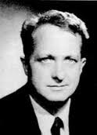
Zero Counts
Zipf’s Law (long tail phenomenon)
A small number of events occur with high frequency
A large number of events occur with low frequency
You can quickly collect statistics on the high frequency events
You might have to wait an arbitrarily long time to get good statistics on low frequency events
Result
Our estimates are necessarily sparse! We have no counts at all for the vast number of events we want to estimate.
Answer
Estimate the likelihood of unseen (zero count) N-grams!

Slide 32
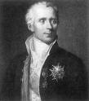
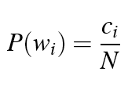
Laplace Smoothing
Also called Add-One smoothing
Just add one to all the counts!
Very simple
MLE estimate:
Laplace estimate:
Reconstructed counts:

Slide 33
BERP Bigram Counts

Slide 34
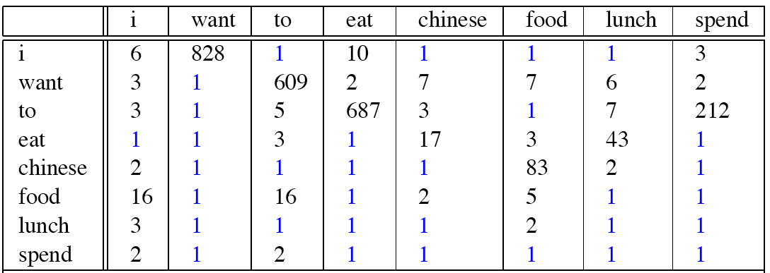
Laplace-Smoothed Bigram Counts

Slide 35
Laplace-Smoothed Bigram Probabilities

Slide 36
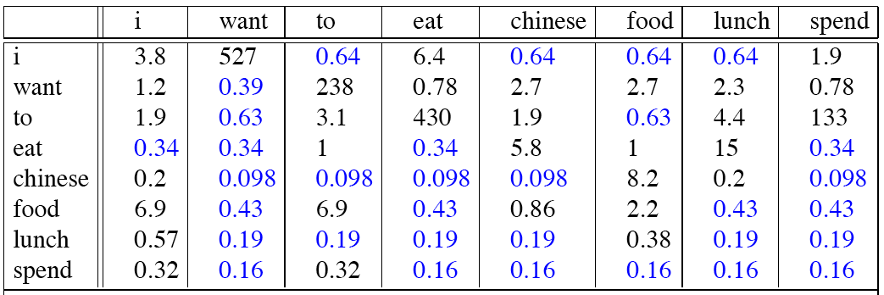
Reconstituted Counts

Slide 37
Reconstituted Counts (2)

Slide 38
Big Change to the Counts!
C(want to) went from 608 to 238!
P(to|want) from .66 to .26!
Discount d= c*/c
d for “chinese food” =.10!!! A 10x reduction
So in general, Laplace is a blunt instrument
Could use more fine-grained method (add-k)
But Laplace smoothing not generally used for N-grams, as we have much better methods
Despite its flaws Laplace (add-k) is however still used to smooth other probabilistic models in NLP, especially
For pilot studies
In document classification
Information retrieval
In domains where the number of zeros isn’t so huge.

